Slide 1
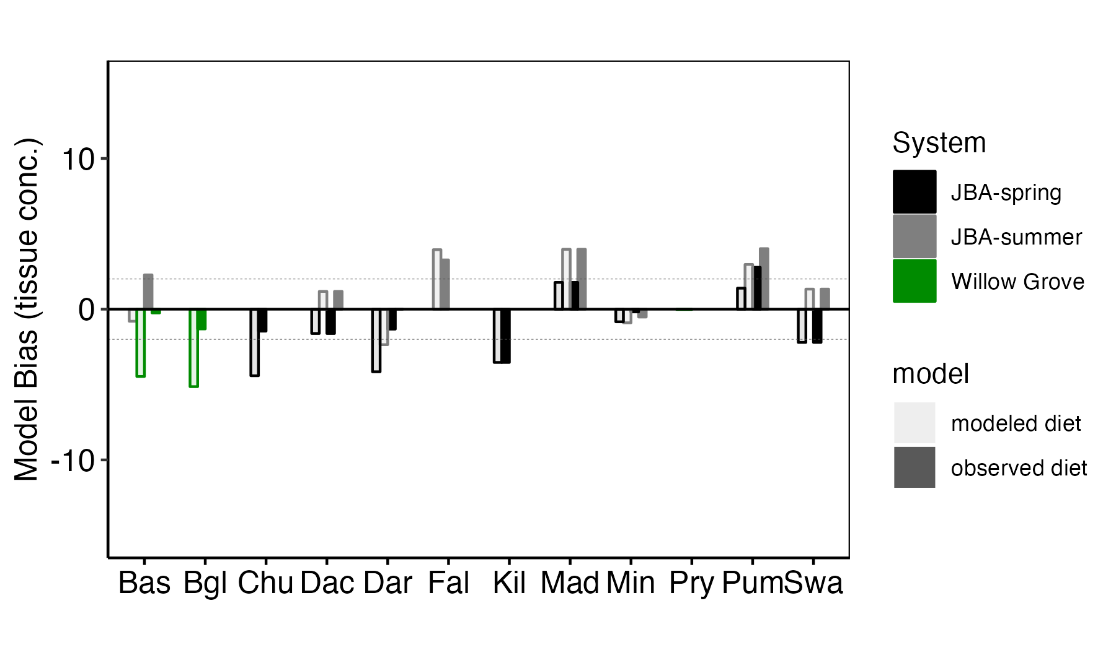
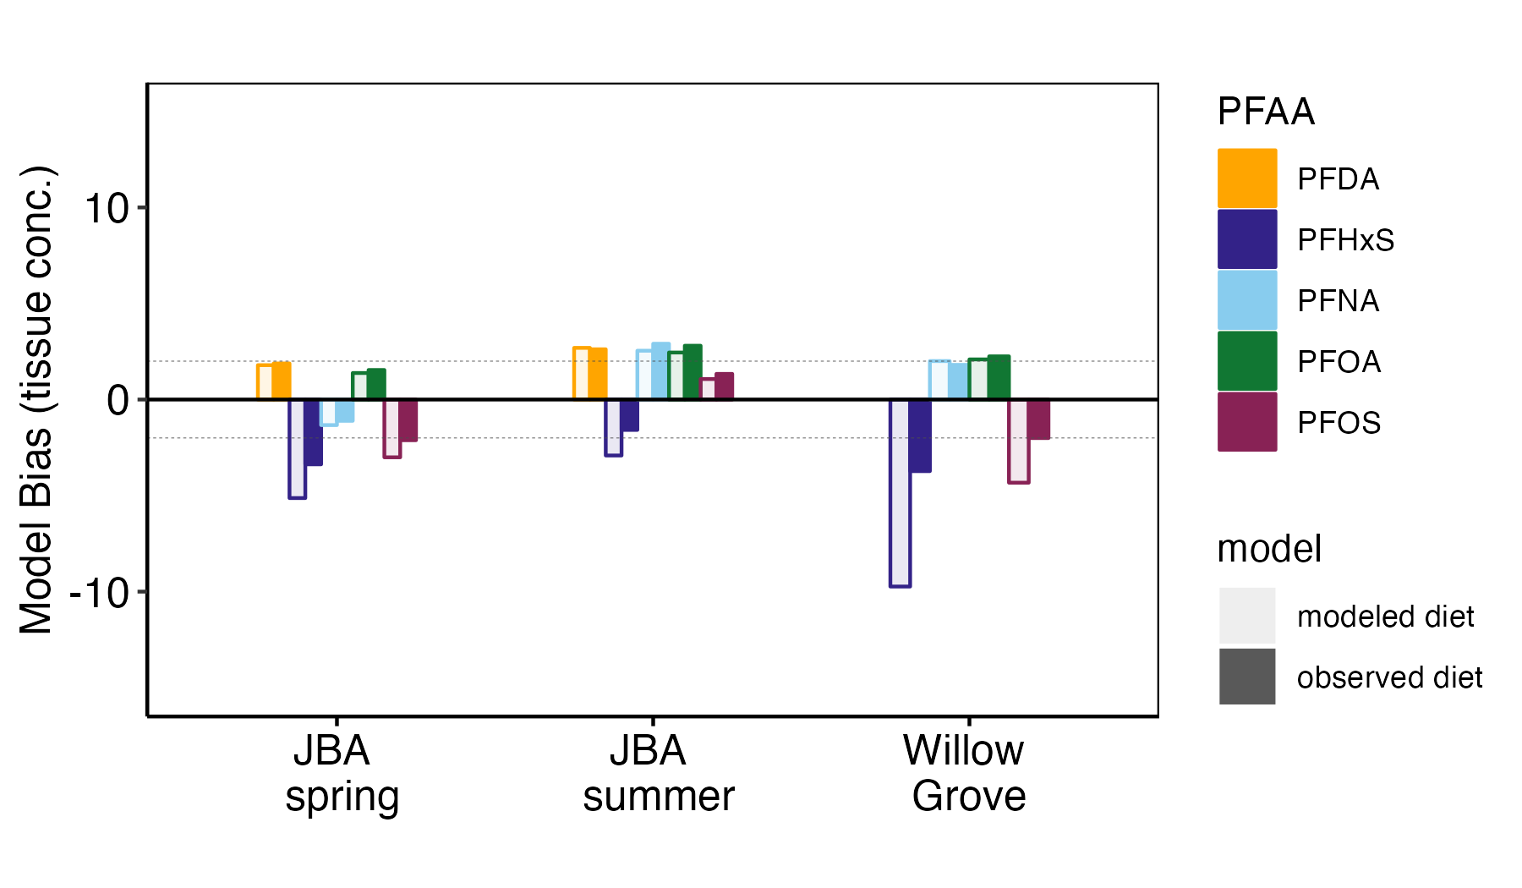
Figures for SETAC poster
A
B

Slide 2
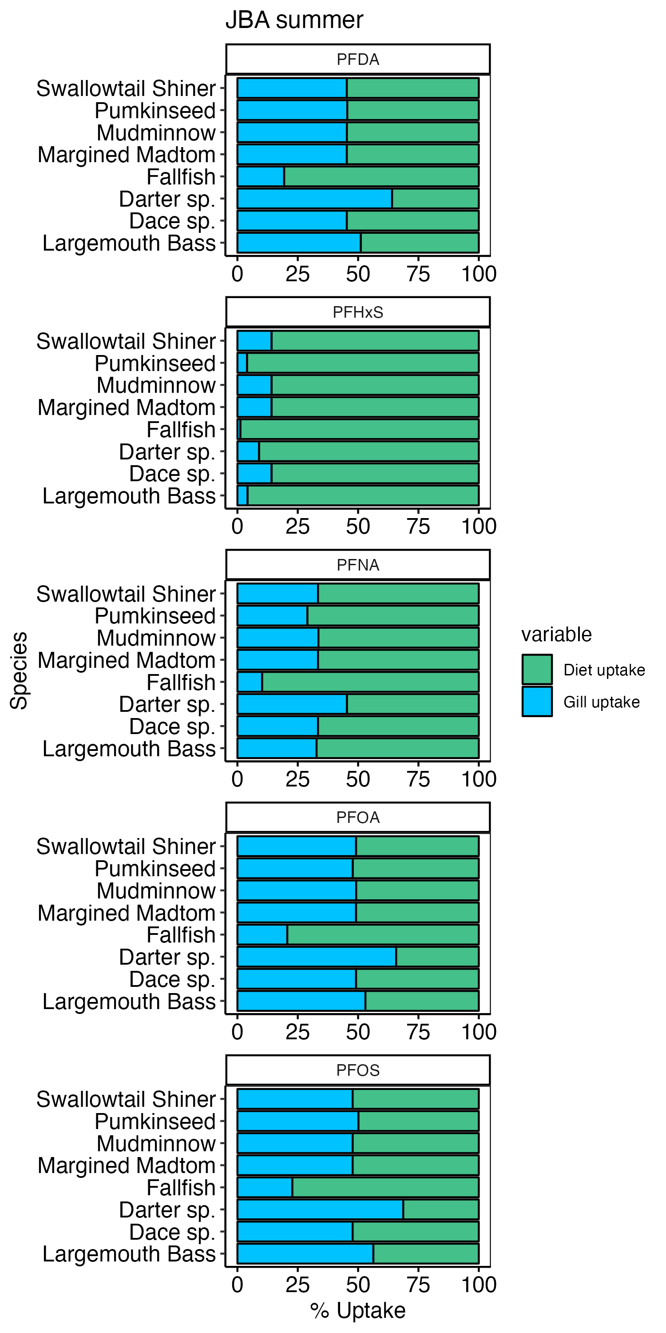

Slide 3
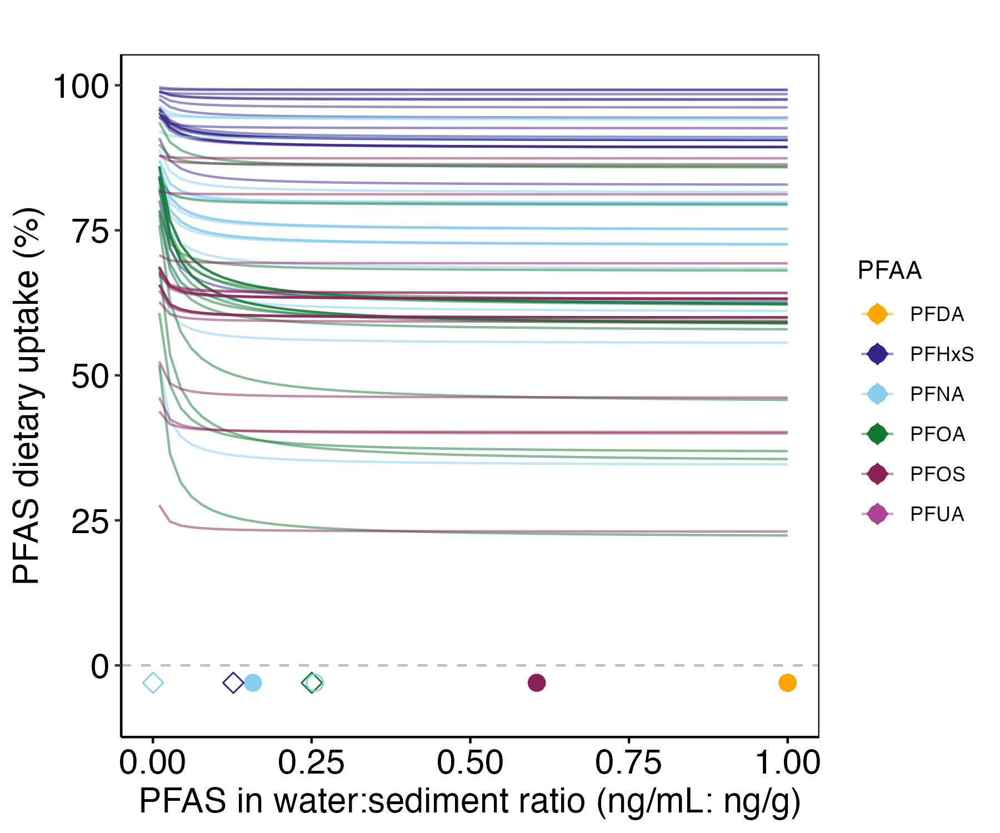
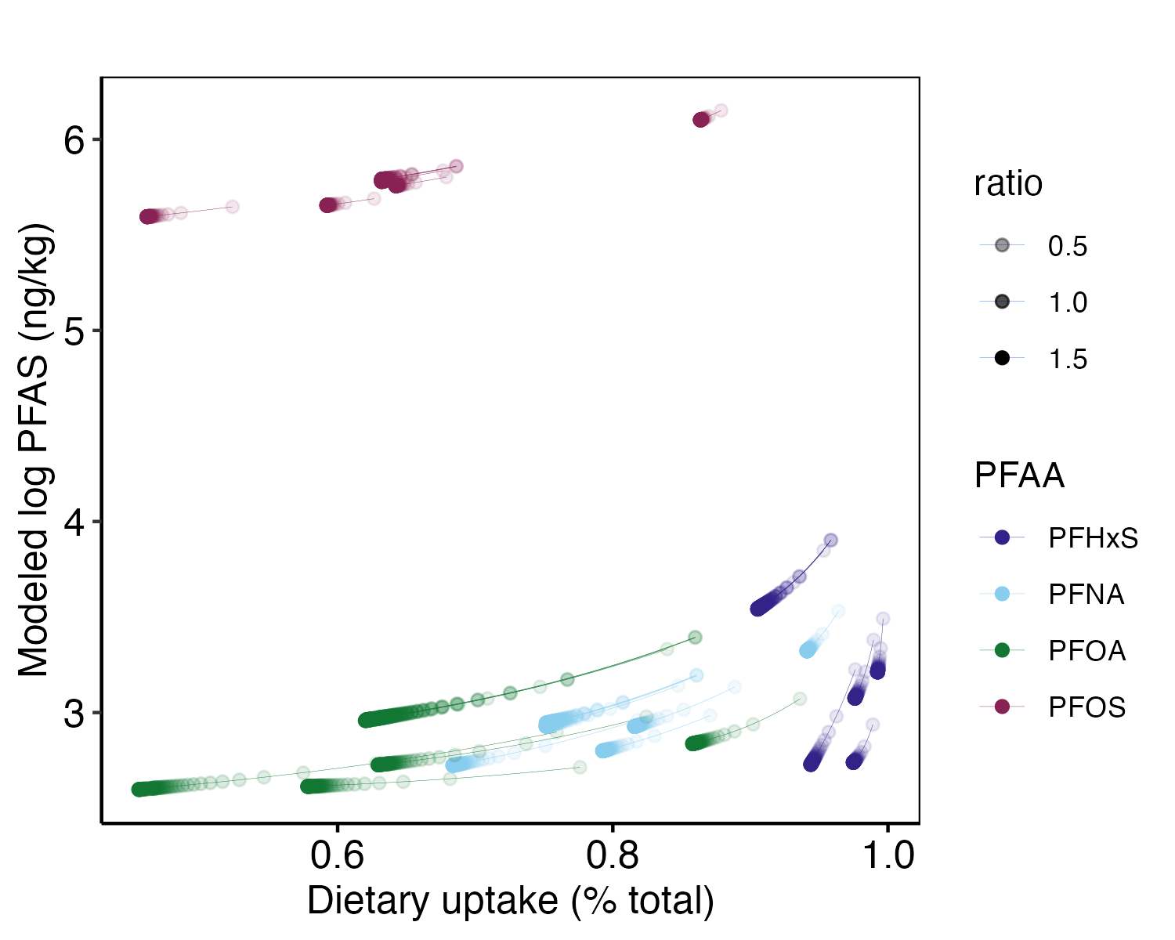
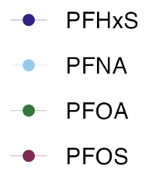
Lighter color marks
lower water:sediment PFAS ratio
Measured ratios

Slide 4
Gill uptake mostly body size driven

Slide 5
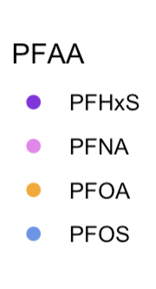
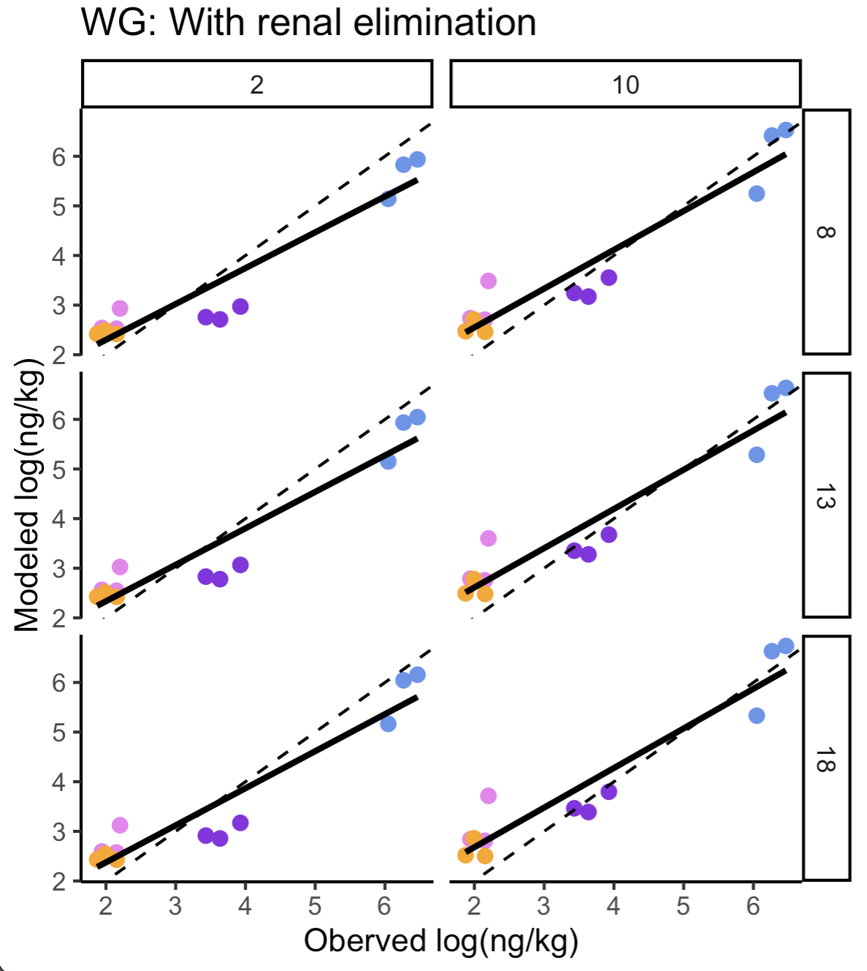
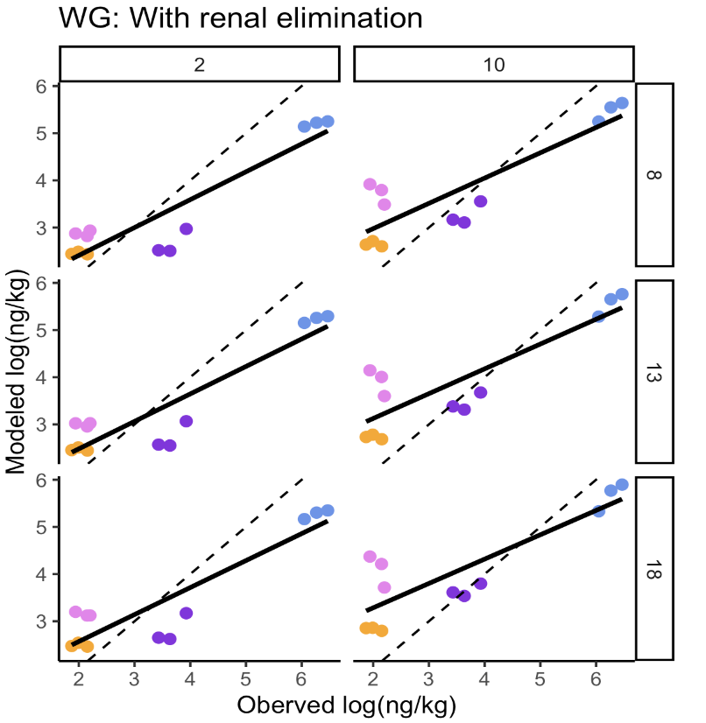
Jun 8
The provided food web need more work, this difference indicates that the food web is off.
OXYGEN LEVELS
UCSB EEMB ghosts and then give leave of abs
TEMPERATURE

Slide 6
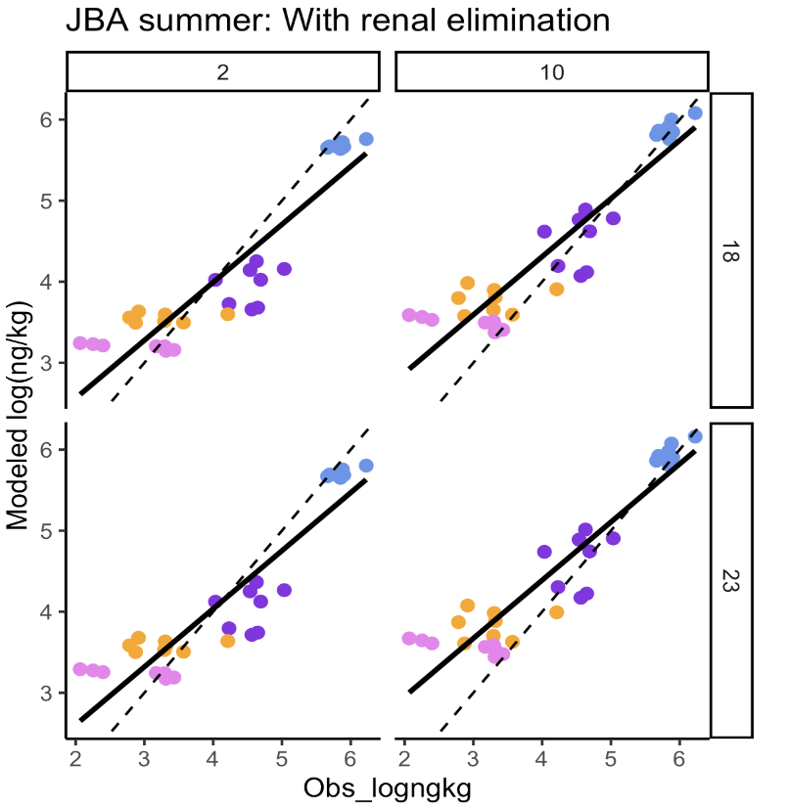
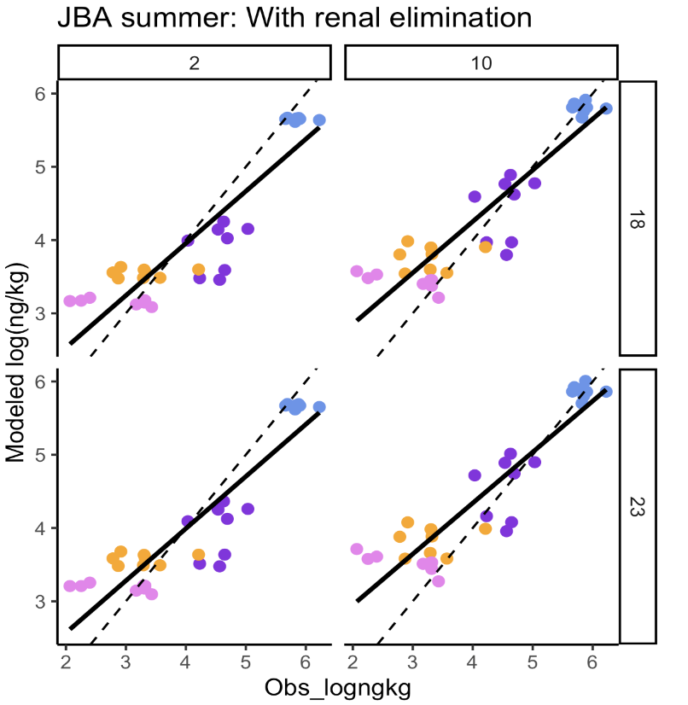
OXYGEN LEVELS
TEMPERATURE

Slide 7
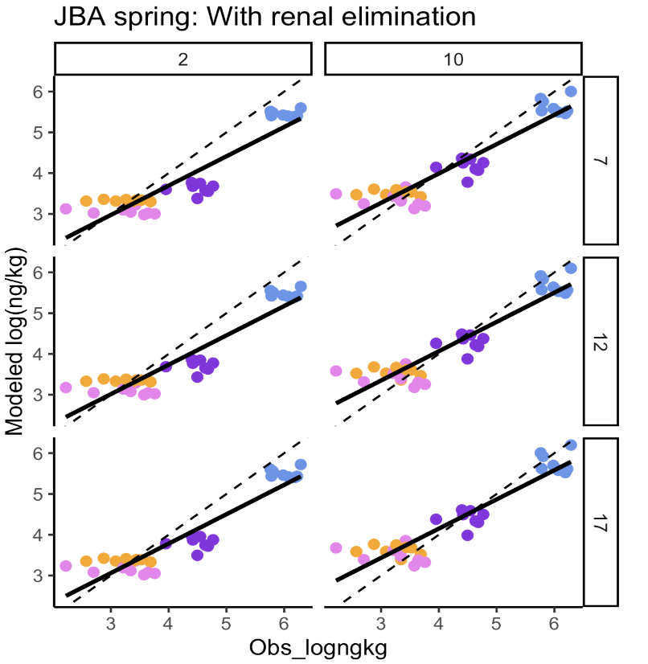
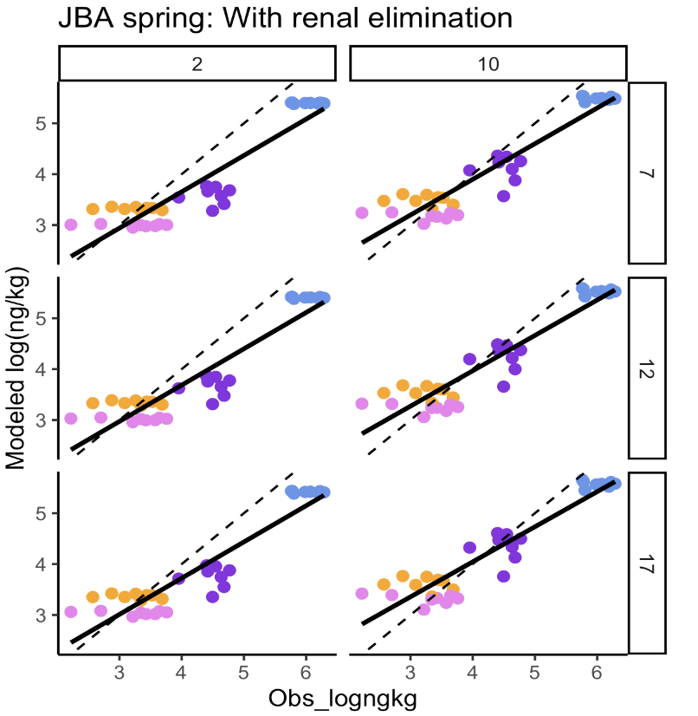
OXYGEN LEVELS
TEMPERATURE

Slide 8
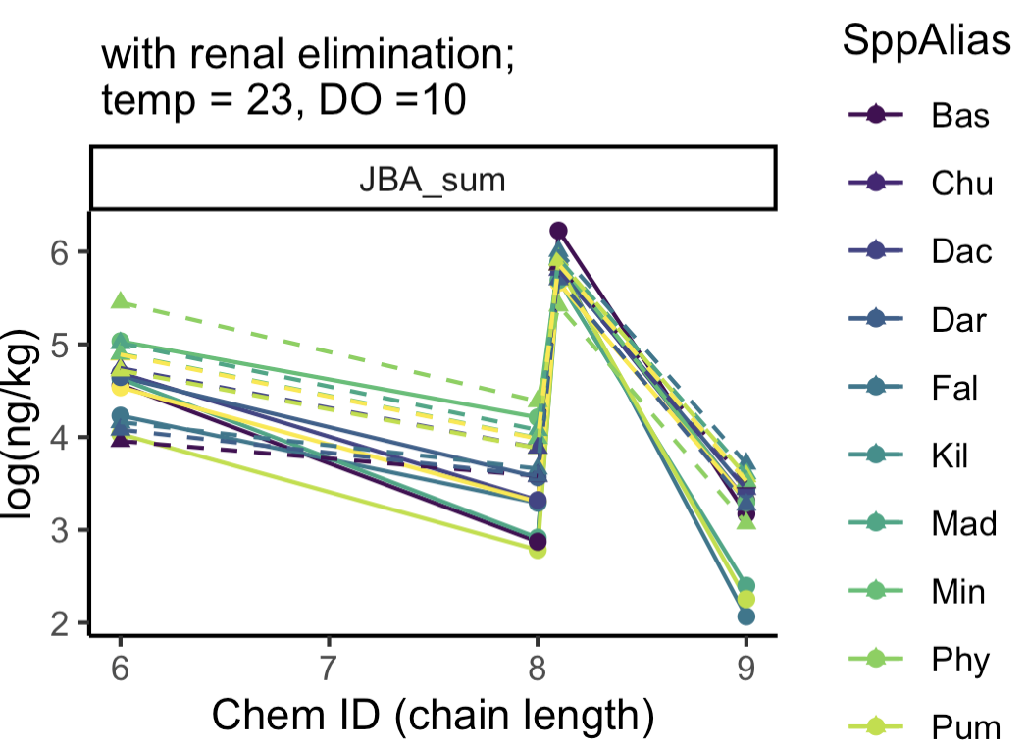
Predicted modeled concentrations, not diet
PFOS
PFNA
PFHxS
PFOA

Slide 9
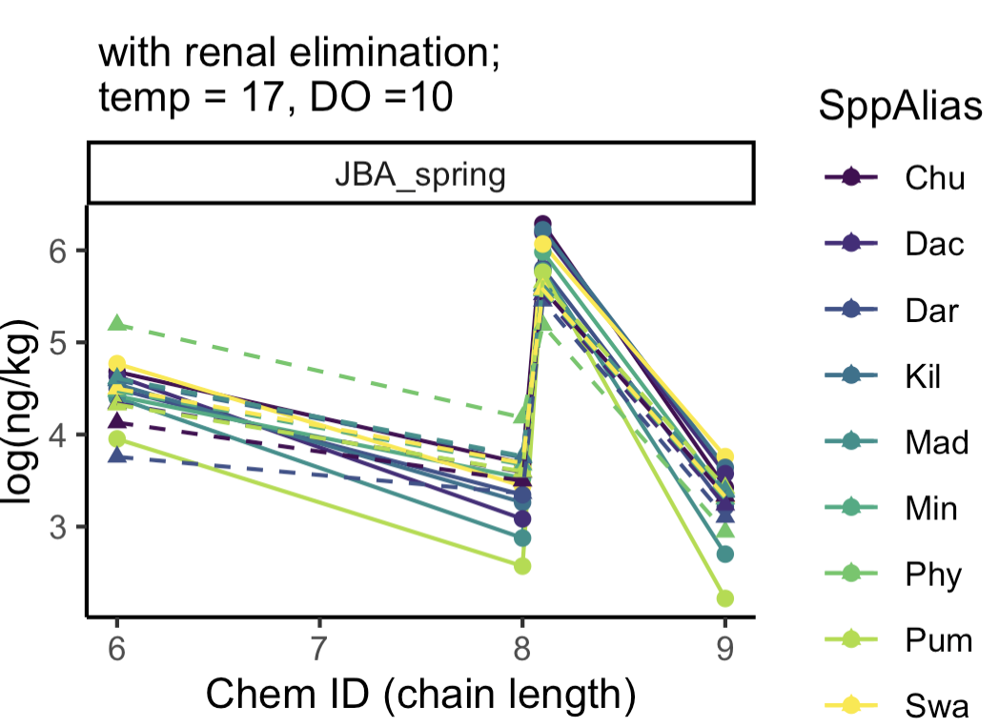
Predicted modeled concentrations, not diet
PFHxS = 6
PFOS = 8
PFOA = 8
PFDA = 10
PFUA = 11

Slide 10
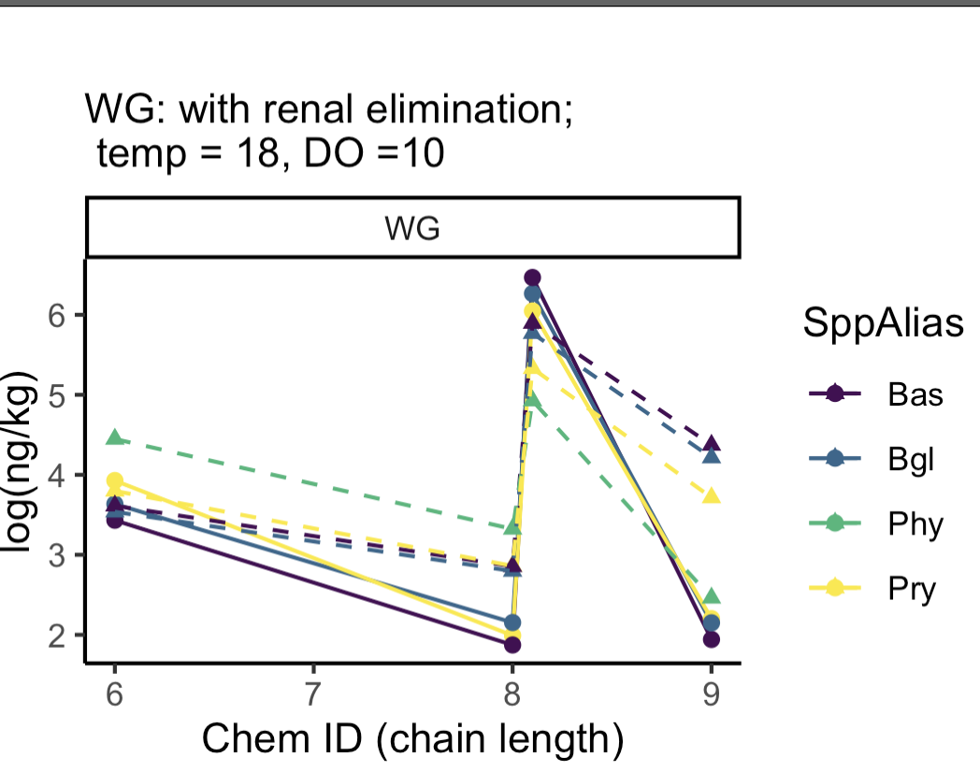
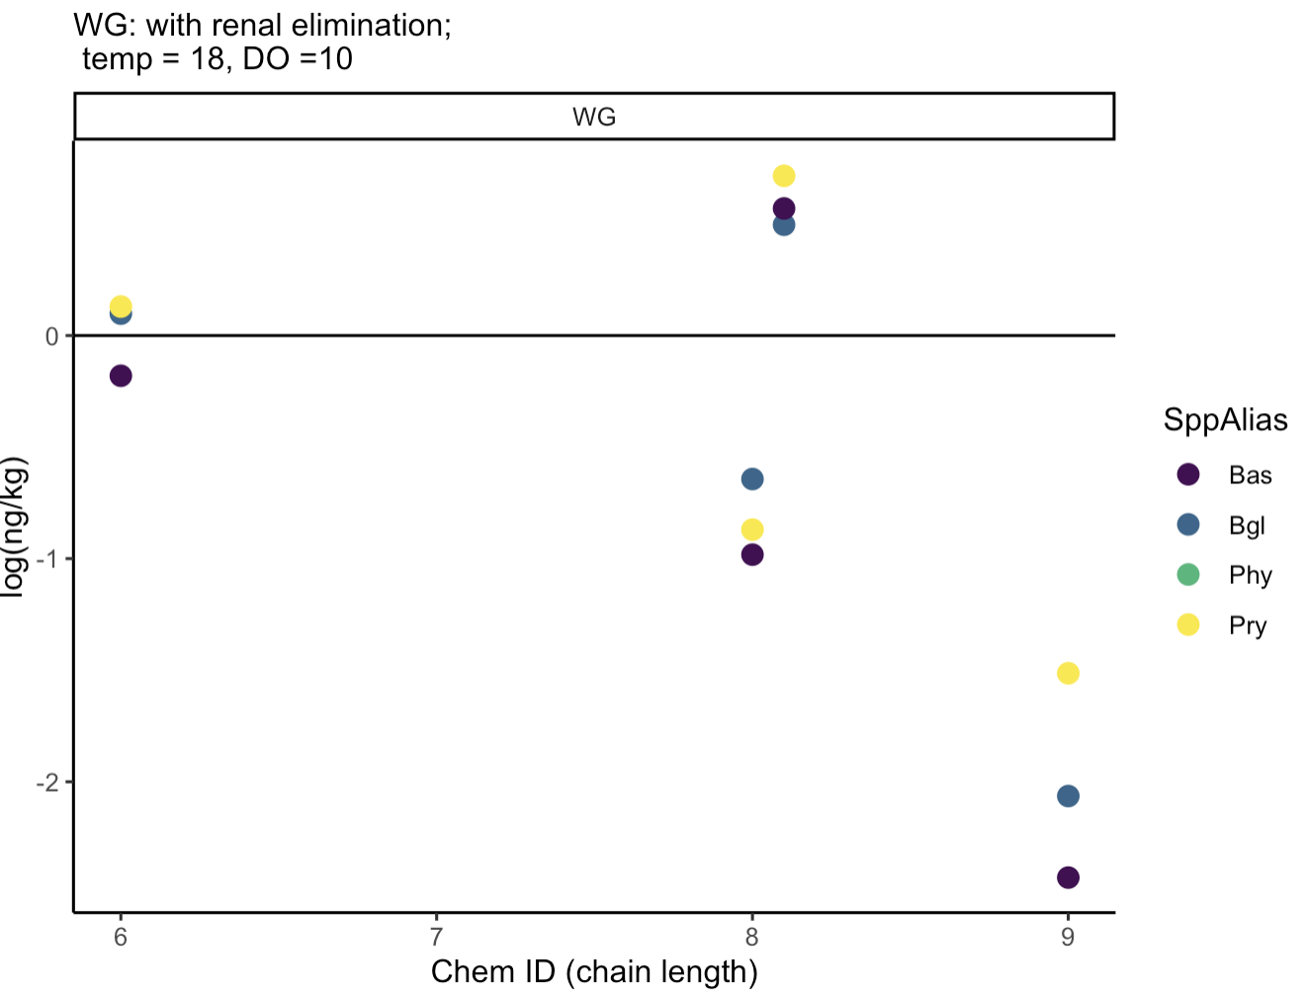
Predicted modeled concentrations, not diet
PFHxS = 6
PFOS = 8
PFOA = 8
PFDA = 10
PFUA = 11

Slide 11
When predicted tissue concentrations without given diet tissue PFAS concentrations of each food web compartment, the modeled data is much more sensitive to DO.
Next to modulate:
Season specific diet?
Feeding rate
Metabolism ~ ventilation volume (from Arnot and Gobas)

Slide 13
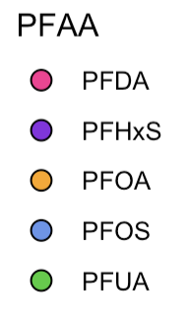
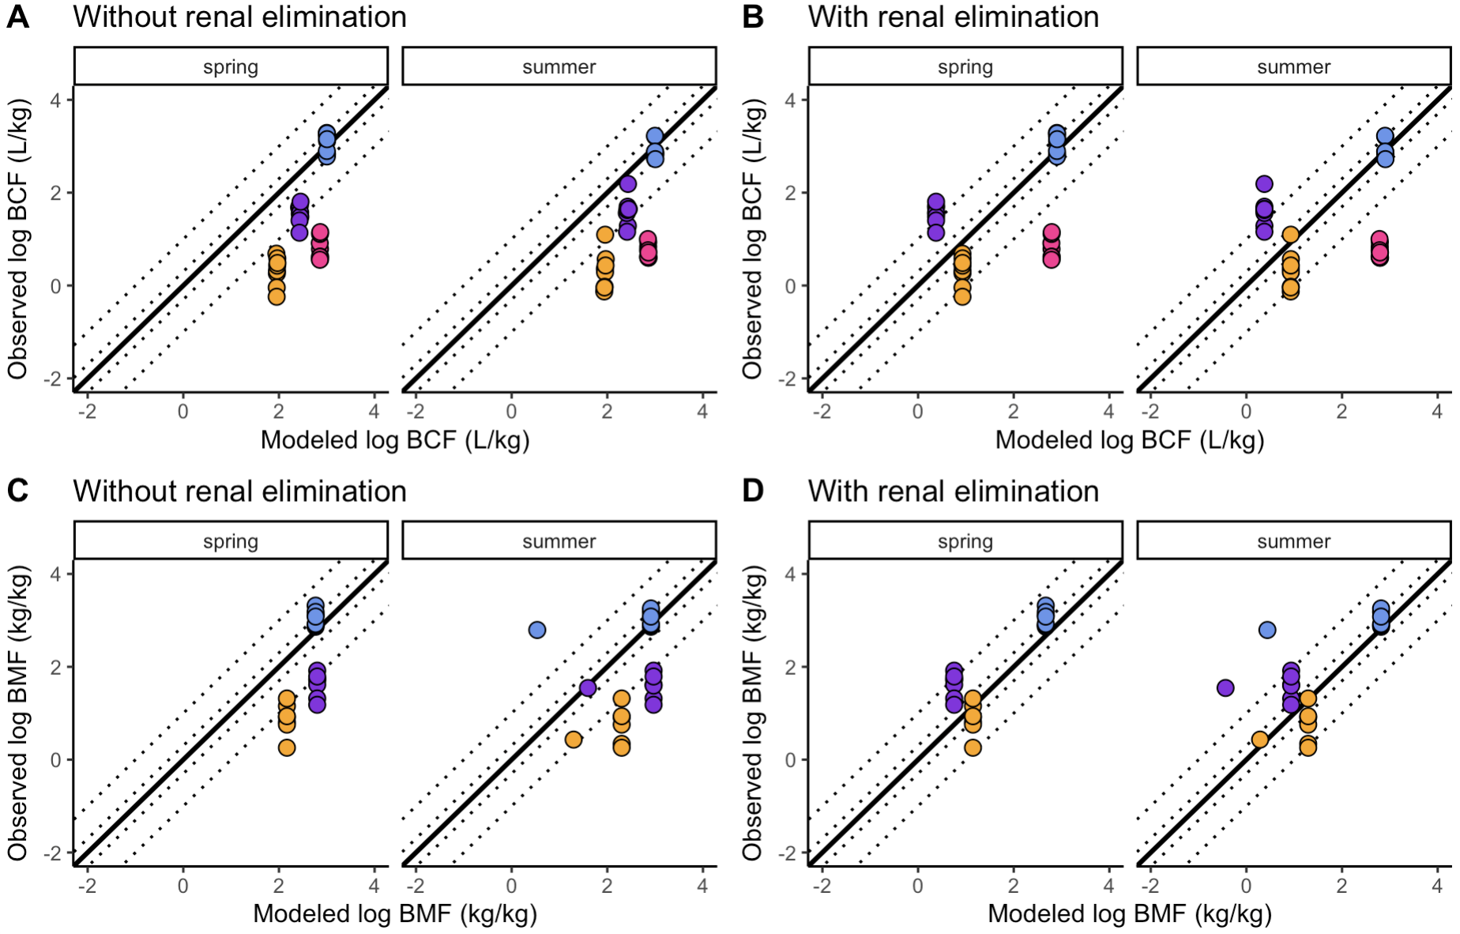
Each point is different species. the only way species really differ is by body size
(e.g. no species specific physiology).
Diet:
Estimated very minimal, mainly sediment and water PFAS exposure, except Large mouth bass.
Sediment and water PFAS:
Average of all recorded values for the season.

Slide 14
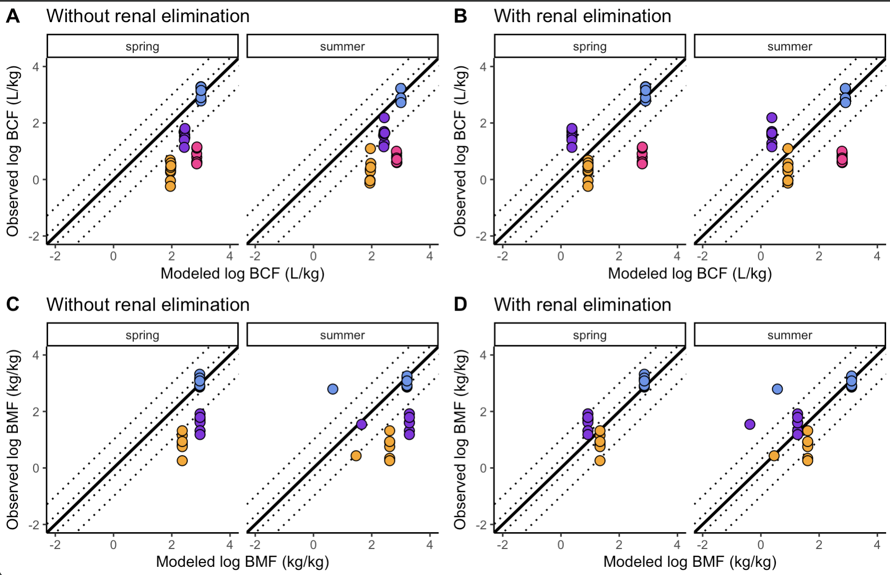
Each point is different species. the only way species really differ is by body size
(e.g. no species specific physiology).
Diet:
Estimated very minimal, mainly sediment and water PFAS exposure, except Large mouth bass.
Sediment and water PFAS:
MAXIMUM of all recorded values for the season.
Only difference from the one before: very slight shift of modeled BMF values to the right (higher BMF)

Slide 15
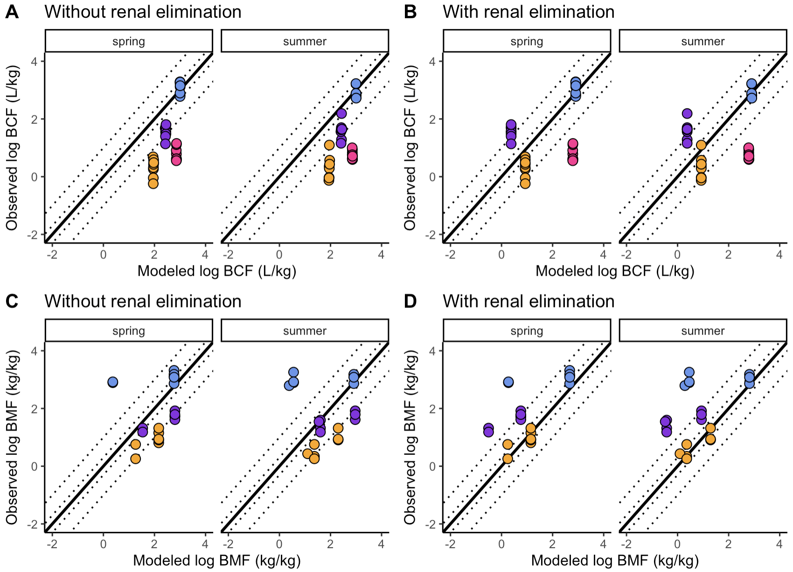
Each point is different species. the only way species really differ is by body size
(e.g. no species specific physiology).
Diet:
Estimated from trophic level, + sediment and water PFAS exposure
Sediment and water PFAS:
AVERAGE of all recorded values for the season.
Difference: more species specific variation in BMF, PFOS responds strongly to dietary exposure. and also PFHxS

Slide 16
Overall BCF not much affected by water sediment and diet exposures.
Interesting because high concentrations in water would matter?
Diet currently drives species specific variation in BMF
Next up:
Incorporate metabolism and link it with G_V (ventilation volume L/d)
Make assumptions about the food web and run a full web model with error due to food consumption rates

Slide 17
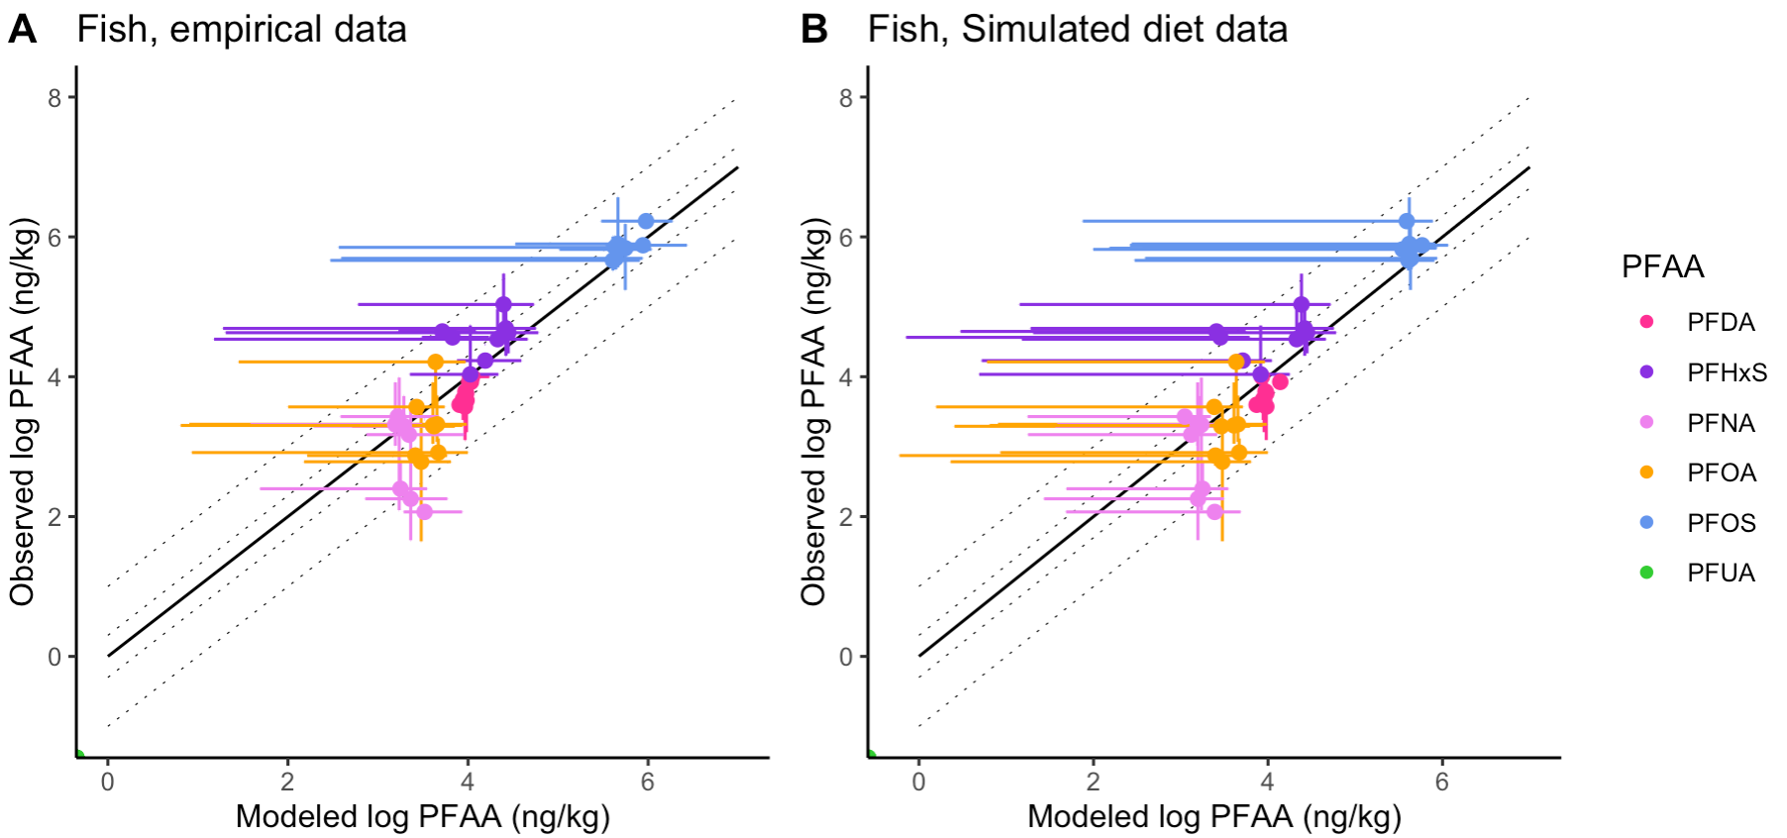
Full web model: SUMMER
Empirical: C_D = using diet data provided for each prey
Modeled: C_D = array(rep(0, numSpecies)) [all zeros]
Error bars: due to sediment and water concentration ranges
e.g. PFDA did not fluctuate much and has no corresponding error here.

Slide 18
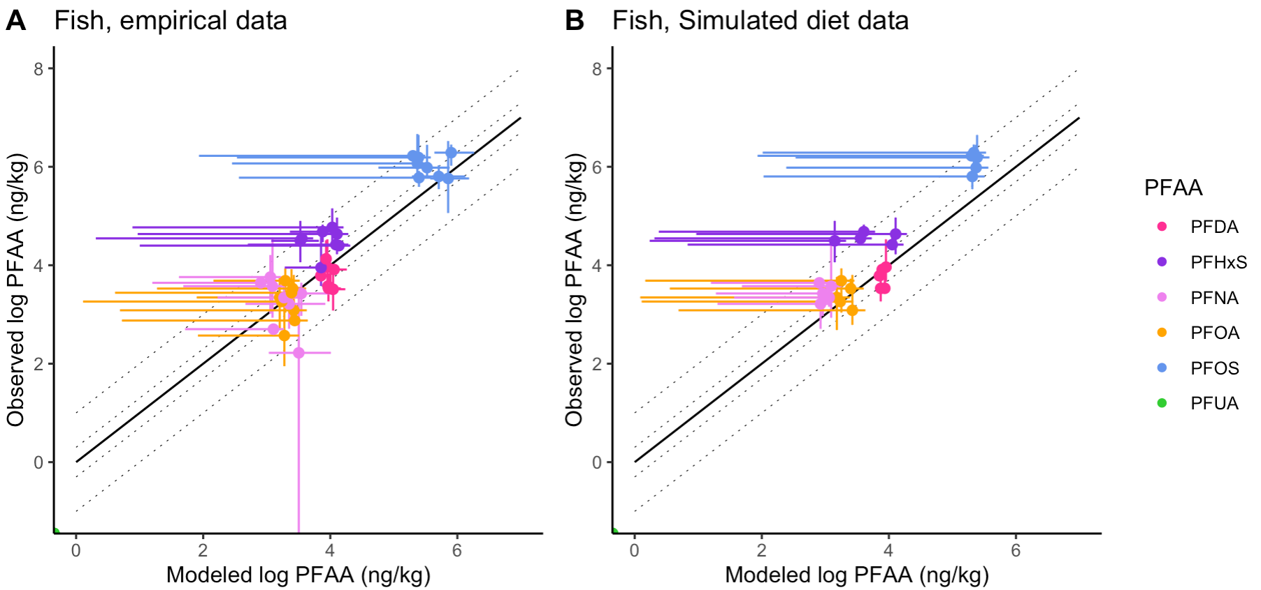
Full web model: SPRING
Empirical: C_D = using diet data provided for each prey
Modeled: C_D = array(rep(0, numSpecies)) [all zeros]
Error bars: due to sediment and water concentration ranges
e.g. PFDA did not fluctuate much and has no corresponding error here.

Slide 19
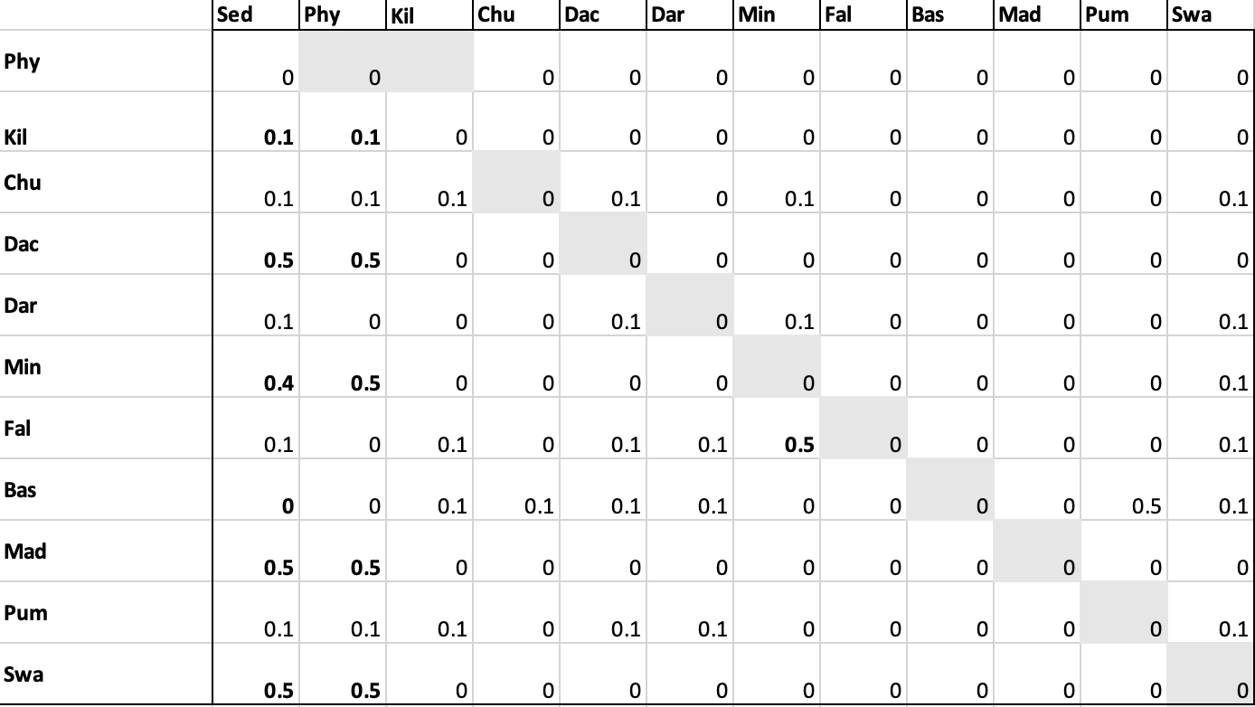
Diet data
Hypoxia
Temperature
Salt
pH
Size from Abbis data

